Slide 1
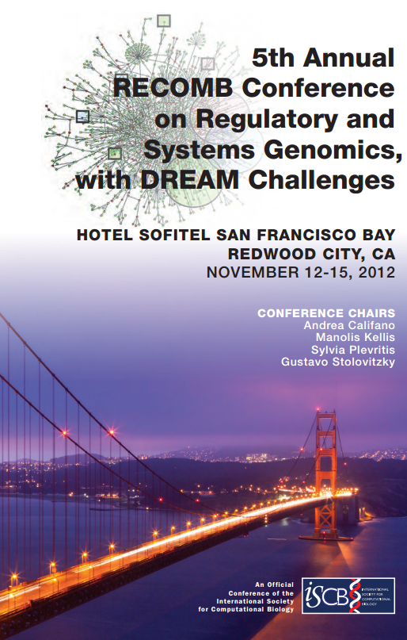
Conference Report
ACGT group meeting
9th January, 2013
Yaron Orenstein

Slide 2
RECOMB satellite conferences
Annual satellite conferences:
  RG: Regulatory Genomics.
  SB: System Biology.
  DREAM Challenges.
Organized by:
  Andrea Califano (Columbia University)
  Manolis Kellis (MIT)
  Sylvia Plevritis (Stanford University)
  Gustavo Stolovitzky (IBM)

Slide 3
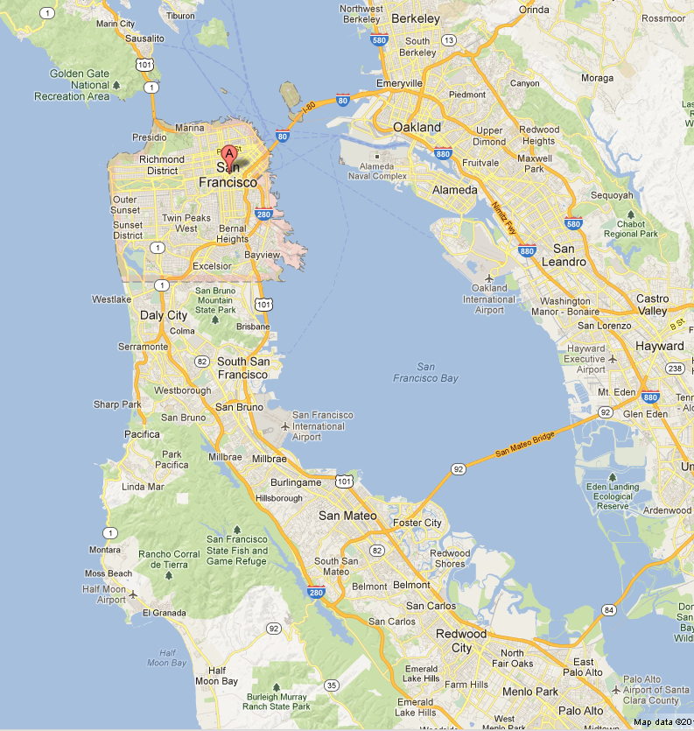
Location
RECOMB takes place:
  West coast.
  East coast.
  Europe.
This year: San Francisco bay area.
Conference at Hotel Sofitel, Bellmont

Slide 4



San Francisco bay area
In-between San Francisco and Stanford.
The whole are is the center of world-wide high-tech and start-up companies, such as Google, Yahoo!, Microsoft and Oracle.
Berkeley and Stanford provide CS graduates.

Slide 5
DREAM Challenges
4 Challenges published:
  The NCI-DREAM Drug Sensitivity Prediction Challenge.
  The DREAM-Phil Bowen ALS Prediction Prize4Life.
  The Network Topology and Parameter Inference Challenge.
  The Sage Bionetworks-DREAM Breast Cancer Prognosis Challenge.

Slide 6
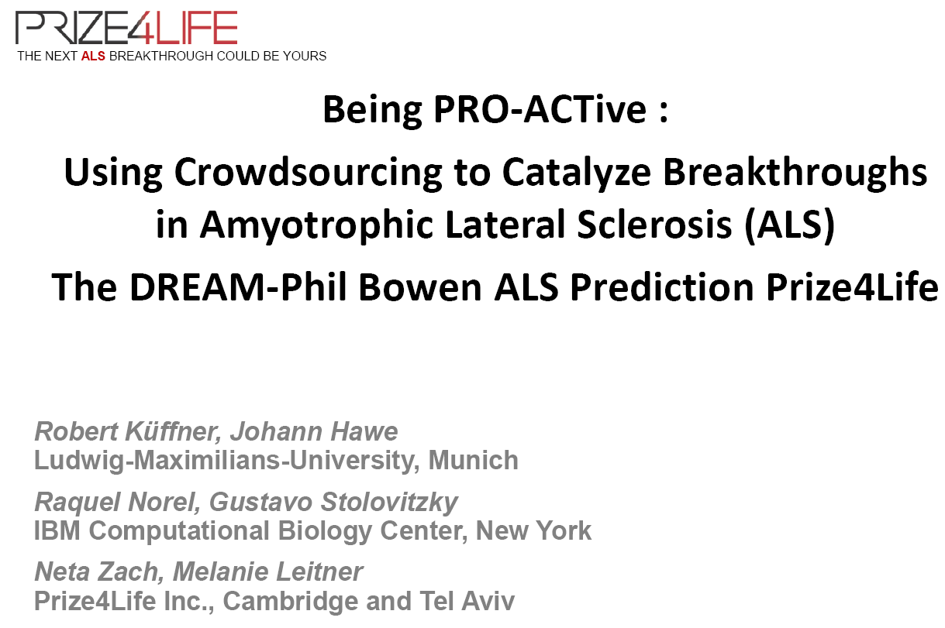

Slides by Neta Zach, scientific director at Prize4Life

Slide 7
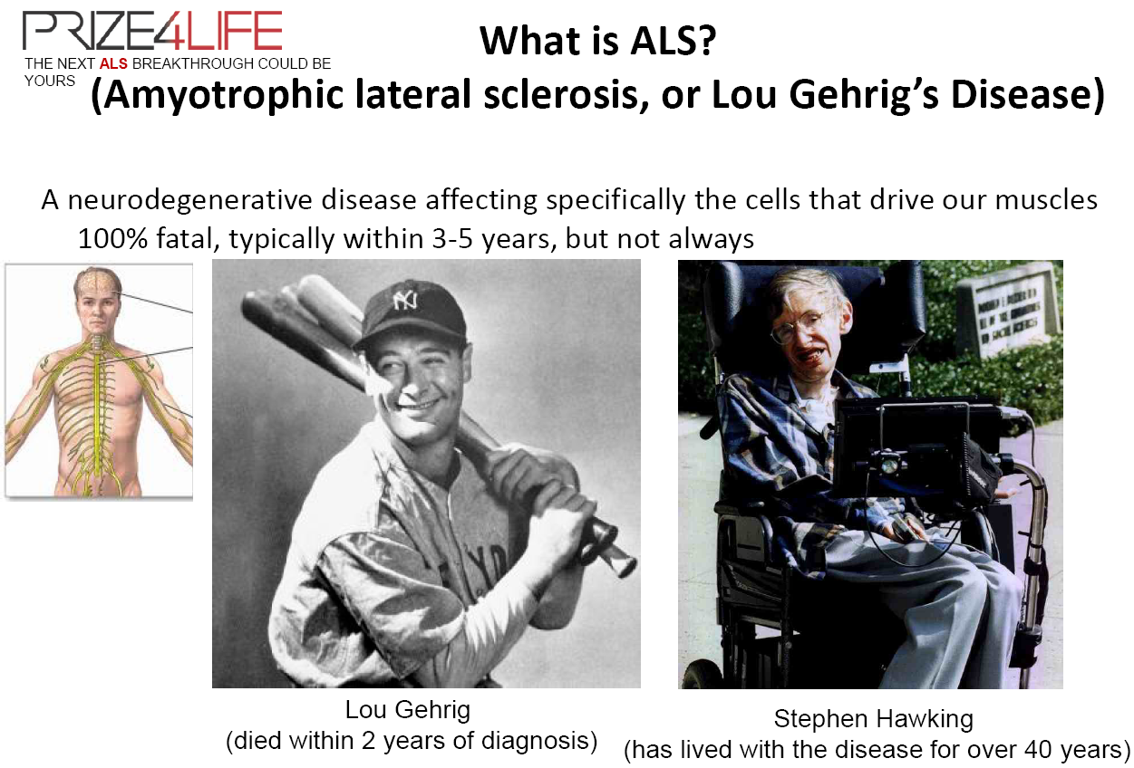

Slide 8

s

Slide 9
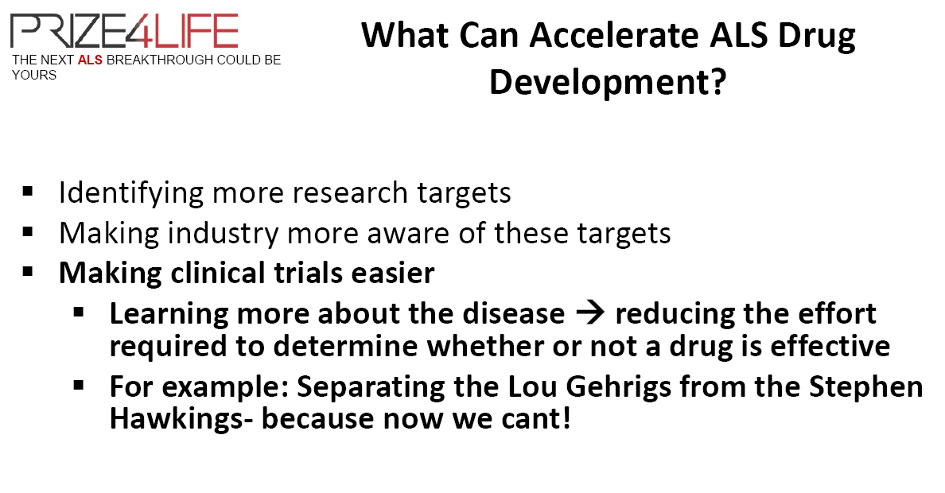
The disease is rare.
Clinical trials cost ~800,000 USD.
Classifying the patients can reduce this cost.

Slide 10
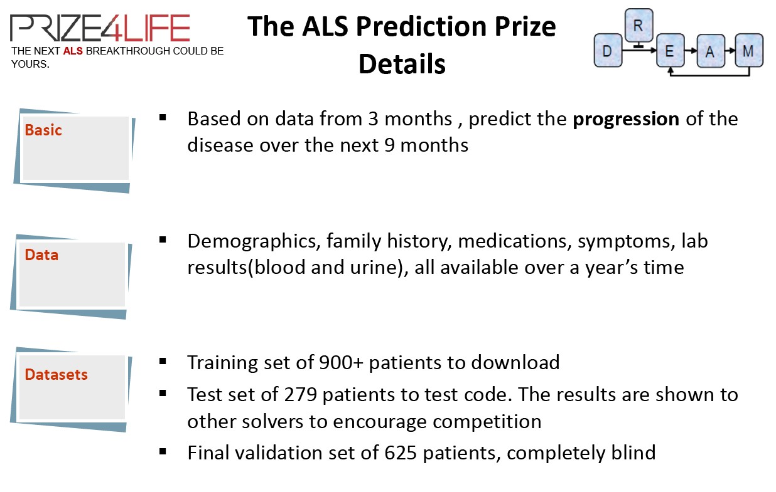

Slide 11
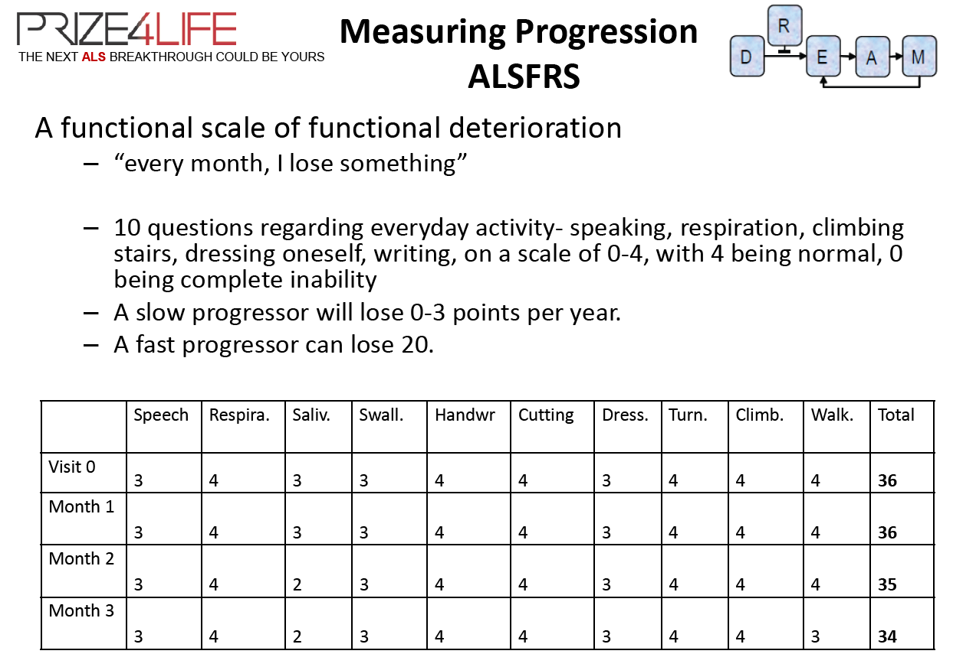
ALS functional rating score

Slide 12
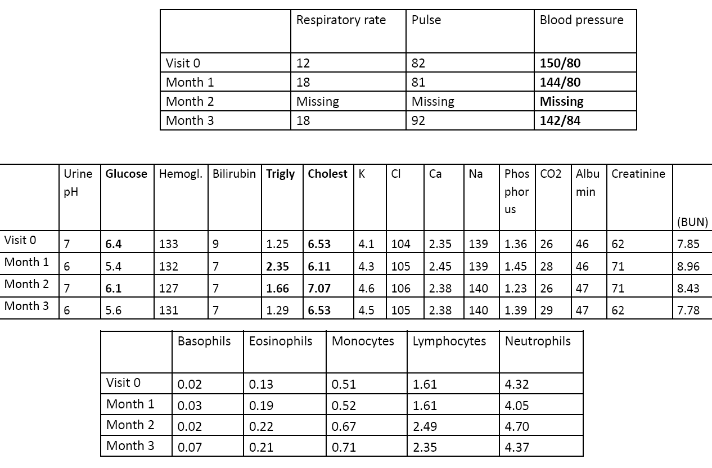
Goal: Predict ALSFRS in month 12

Slide 13
Measuring performance
m1
ALSFRS score
m2
Months
Notes:
Empty plot: describe axis, months/visits versus ALSFRS total score
Full plot: one patient; derived a value describing future disease progression based on month 3+ (gold standard, slope) → target of predictions
3) 0-3 months: data basis for predictions.

Slide 14
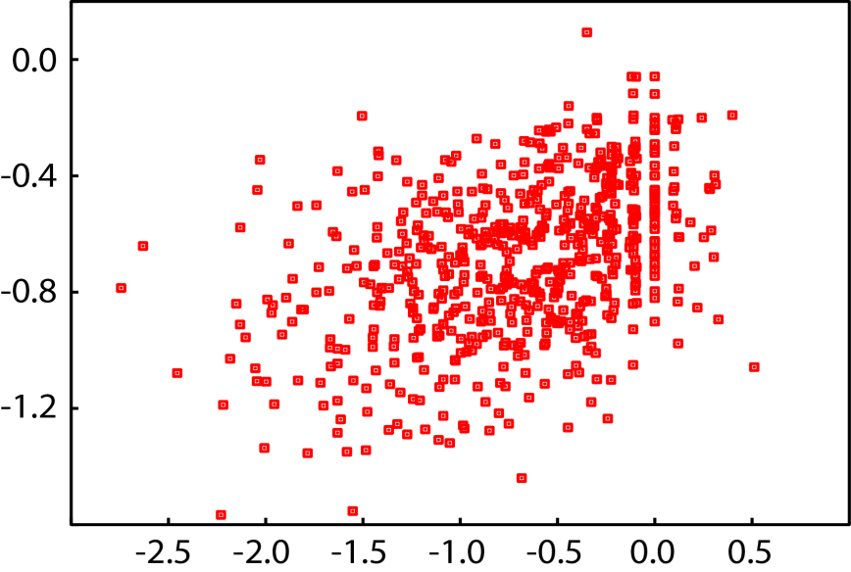
Quantify error
625 patients
p_{i}
s_{i}
Predicted slope P
True slope S
Absolute deviations.
Units ~ measured quantity.
∞ > RMSD > 0
Relative measure. Prediction trends.
-1 < ρ < 1
Better
Better
Notes:
So what we have now are the true slope of progression for 625 patients in the test set
each prediction method gives us corresponding predicted slopes
Scatterplot; evaluation need performance metrics as way to quantify prediction error
example patient: predicted -0.4, true slope -2.0, large absolute deviation: measured by rmsd
gives us one RMSD for each algorithm

Slide 15
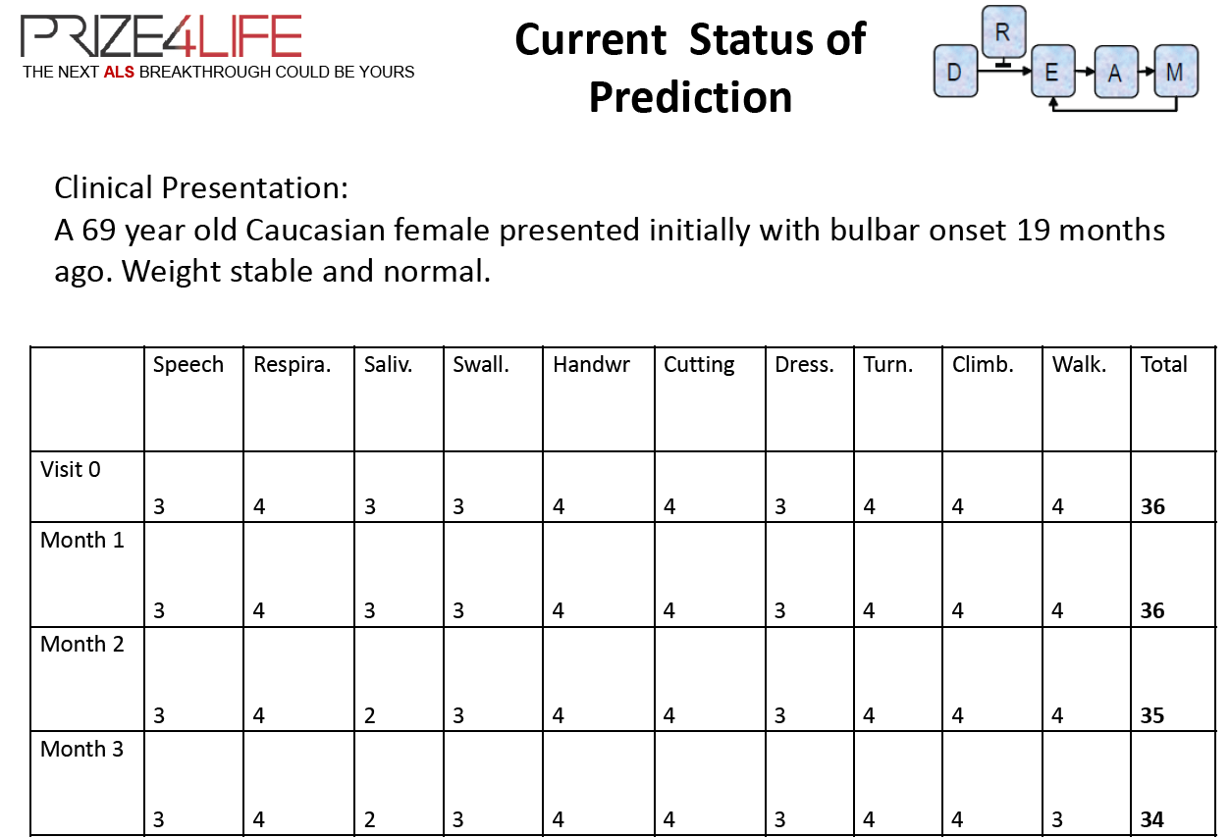
difficulty speaking clearly or swallowing

Slide 16
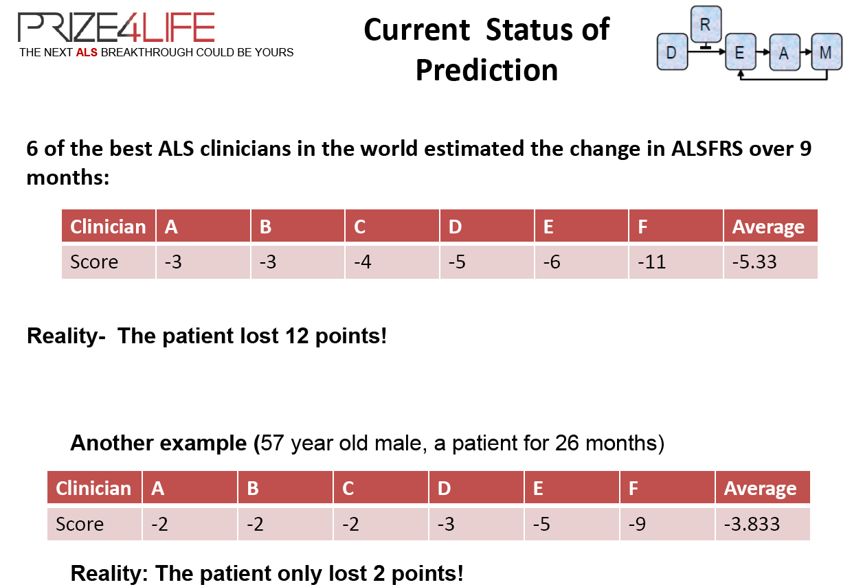

Slide 17
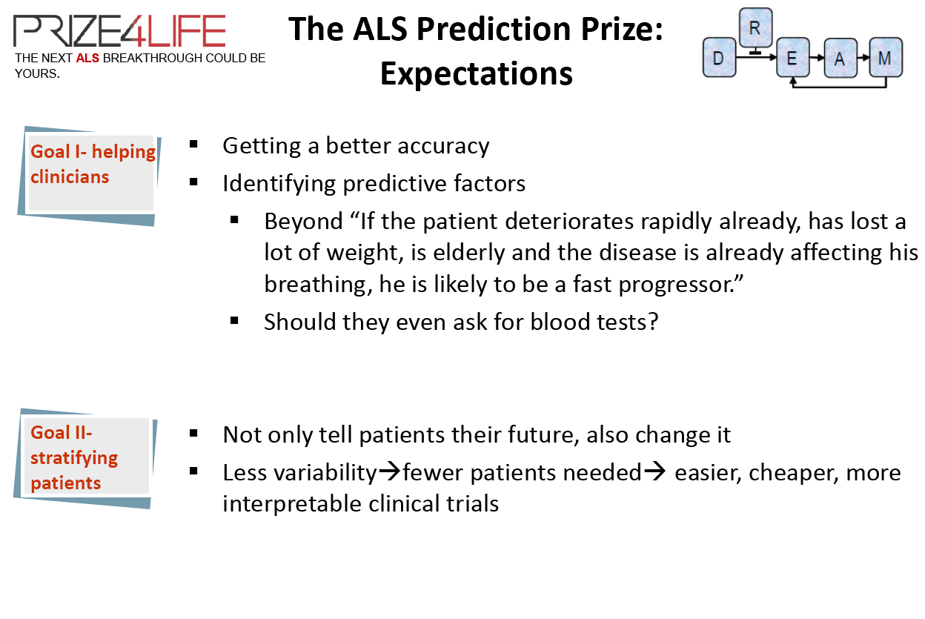

Slide 18

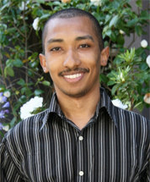
Best performer – 1st place
Lilly Fang and Lester Mackey, Stanford.
Prize money: 25,000 USD.

Slide 19
Static features
Static data – measured once for each patient:
  Demographics (age, sex, race).
  ALS history (time of onset, site of onset).
  Family history and more…
Categorical data as binary indicators.
Total of 49 static features.

Slide 20
Temporal features
Temporal data:
  Calculated mean, std, slope, last value, max,… for:
    ALSFRS question scores.
    Alternative ALS measures (forced & slow vital capacity).
    Weight, height, blood pressure, respiratory rate.
    Lab tests (eventually, unused).
  Computed pairwise slopes (derivative of time series) – and extract same statistics.
Total of 435 temporal features.

Slide 21
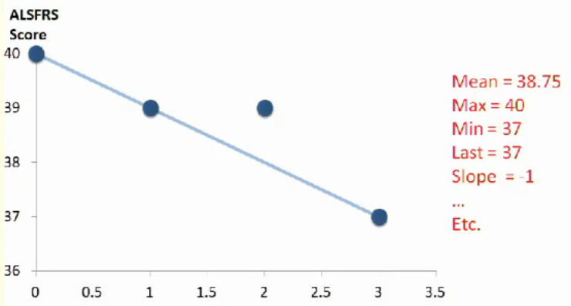
Example
Months

Slide 22
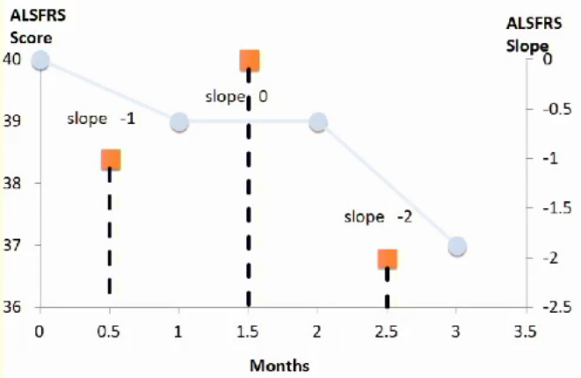
Example

Slide 23
Missing data
Average patient missing 10% of features.
One patient missing 55% of features!
Missing values imputed using median.

Slide 24
Modeling and inference
Regression model
  Future ALSFRS Slope = f(features) + noise
Goal: infer f from data
  Bayesian: Place a prior on f, infer its posterior.
  Bonus: Uncertainty estimates for each prediction.
What prior?
  Flexible and nonparameteric.
    Avoid restrictive assumptions about functional form
  Favor simple, sparse models.
    Avoid overfitting to a large number of irrelevant features

Slide 25
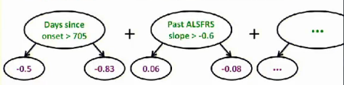
Bayesian additive regression trees*
f(features) = sum of decision trees
Simplicity = tree depends on few features.
  Irrelevant features seldom selected.
Similar to frequentist ensemble methods.
  Boosted decision trees, random forests.
* Chipman, George and McCulloch (2010)

Slide 26

Modeling and inference
We have a prior, need to estimate posterior.
Estimating f: Markov Chain Monte Carlo.
10,000 posterior samples: f₁, f₂, f₃, f₄, …
f₁ =
Prediction: Posterior mean
  Average of f₁(features), f₂(features), f₃(features),..
Variance reduction
  Average predictions of 10 BART models

Slide 27
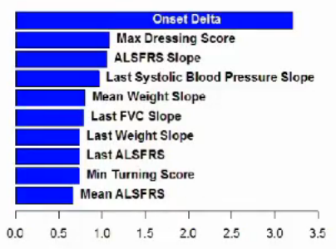
Most important features
Shown by average usage.
  Many pairwise slope features.
  Lab data was not used.
More days since onset => slower progression

Slide 28
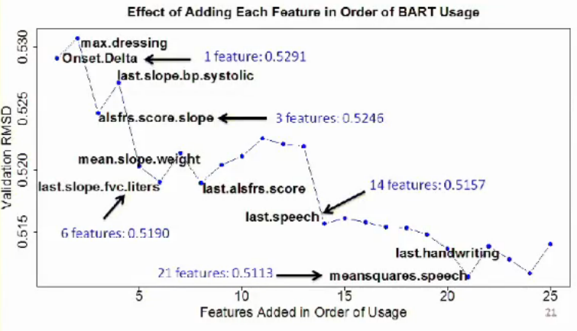
Effect of most important features
Almost as good as all features

Slide 29
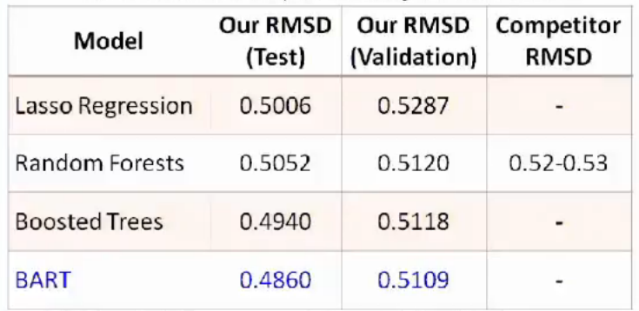
Model comparison
Additive decision trees especially effective.
Featuriziation is a main differentiator of competitors.

Slide 30
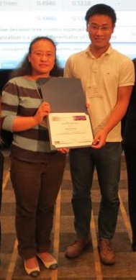
Best Performer – 2nd place
Guang Li, Liuxia Wang, SENTRANA.
Company that solves business problems using mathematical modeling.
The son of the owner has ALS, and the prize money (25k$) was donated.

Slide 31
Data preparation
Lots of missing data, different measurements for different variables, too much data.
First step: choice of variables according to:
  Literature: age, time of onset, etc.
  Exploratory analysis (next slide)

Slide 32
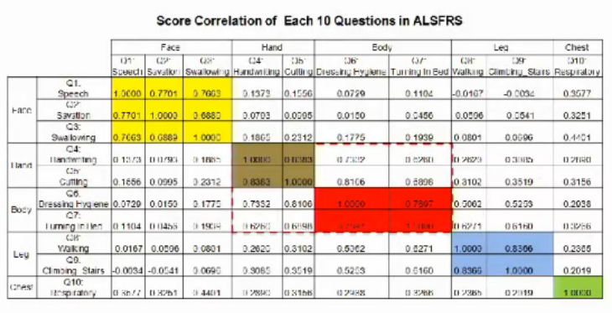
Exploratory analysis
Grouped features into 5 categories based on correlation matrix.

Slide 33
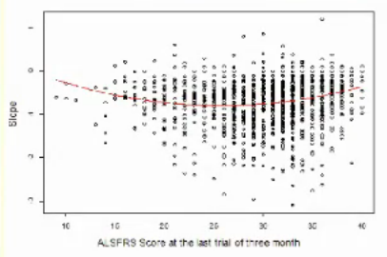
Exploratory analysis
Found a non-linear relationship between initial disease condition and future progression slop.
Fitted a quadratic model.
Hypothesis: good and bad conditions are relatively stable.

Slide 34
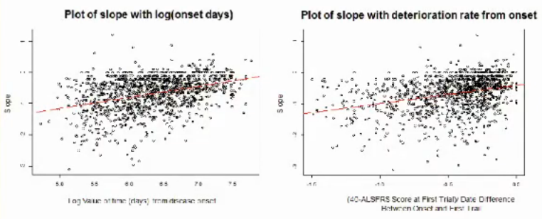
Exploratory analysis
Two good predictors: time of onset, deterioration rate since onset (40-ALSscore)/(onset date-first trial date).

Slide 35
ALS questionnaire features
Variable category | Variable name | Definition logic
Three month ALS RS Score Information | Three_month_slope | Data exploration
 | MSC_three_month_slope | Data exploration
 | First_score | Data exploration
 | Score_three_moths | Data exploration
 | Score_three_month_26_abs | Data exploration
 | Face | Data exploration
 | Hand | Data exploration
 | Body | Data exploration
 | Leg | Data exploration
 | Chest | Data exploration
 | Face_three_month_slope | Data exploration
 | Hand_three_month_slope | Data exploration
 | Body_three_month_slope | Data exploration
 | Leg_three_month_slope | Data exploration
 | Chest_three_month_slope | Data exploration
Missing data – imputed when possible (using the mean or the mode), otherwise binary variable to indicate it.

Slide 36
More features
Variable category | Variable name | Definition logic
Onset Information | Onset delta log | Literature and data exploration
 | Onset drag delta diff | Literature and data exploration
 | Drag delta missing ind | Missing value
 | Onset site | Literature
 | Onset slope | Data exploration
 | Onset_age | Literature and data exploration
Family History | Als_ind | Literature
 | Neuro_disease_ind | Literature
Vital Capacity Information | Tvc_slope | Literature and data exploration
 | Svc_slope | Literature and data exploration
 | Vc_slope | Inconsistent measures
 | Fvc_ind | Inconsistent measures
Lab Test | Uric_acid_value | Literature and data exploration
 | Uric_acid_value_missing_ind | Missing value
Vital Signs | Weight_slop | Data exploration
 | RR_slope | Data exploration
 | Avg_RR | Data exploration
 | Pulse_slope | Literature and data exploration
 | Average_pulse | Literature and data exploration

Slide 37
Machine learning
Used RANDOM FOREST: creates many random trees, and aggregate results.
Rationale for using 4 different models:
  Many missing values.
  Inconsistency in measurements.
Variables | Missing data percentage
Uric acid value | 87.22%
Time difference between onset and diagnosis | 77.56%

Slide 38
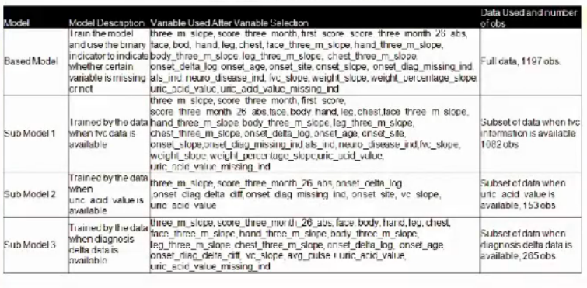
Algorithm
Build 4 different models (due to missing data and variables inconsistency).
All data
Only if vital capacity data is available
Only if uric acid data is available
Only if onset to diagnosis time is available

Slide 39
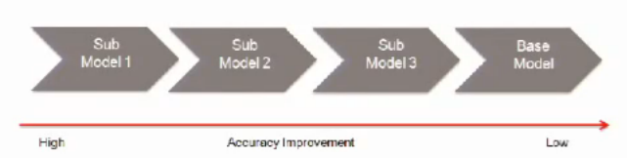
Model usage
Each model learned using random forest.
For each subset of data, the sub models improve performance.
Use one model (choose by best performance).
Sub model | Subset of test data | Reduce of RMSD | Number of obs. in the subset of the validation data
1 | Vital capacity information | 0.01 | 263
2 | Uric acid values | 0.005 | 33
3 | Diagnosis to onset time | 0.003 | 59

Slide 40
Suggested hypotheses
Most important variables:
  Length of time for onset.
  The deterioration rate from onset till now.
  The vital capacity change rate.
  The historical ALSFRS score change rate.
  The pulse change rate, the weight change rate.
  The initial score of ALSFRS.
  The historical deteroration rate of face score.
Some shared among models, and some are specific.

Slide 41
Suggested questions
Is there heterogeneity in progression rate?
Are there stages in the disease?
Why are body parts correlated?
Why is chest function the last to deteriorate?

Slide 42


Slides by Robert Küffner
Robert Küffner, Johann Hawe
Ludwig-Maximilians-University, Munich
Raquel Norel, Gustavo Stolovitzky
IBM Computational Biology Center, New York
Neta Zach, Melanie Leitner
Prize4Life Inc., Cambridge and Tel Aviv
Scoring ALS predictions

Slide 43
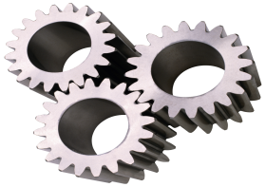
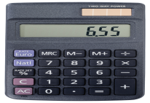
Overview
ProACT
ProACT
Patient1
Patient6
ALSFRS
Patient3
Patient9
Patient1
True Progression
Baseline
performance
Predicted Progression
Notes:
1) Extract ALSFRS-values from PROACT and derive a gold standard describing future disease progression (mention that other data is available, too)
2) Established baseline prediction method = rather simple model
→ prediction is a little off

Slide 44

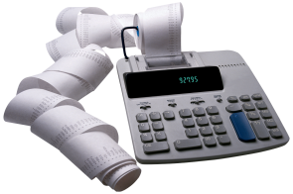
Overview
ProACT
ProACT
Patient1
Patient6
Patient3
Patient9
Patient1
…
Baseline
performance
Notes:
participants used much more advanced models
We used baseline + participant predictions to determine winners

Slide 45
Gold standard
ALSFRS score
Months
Notes:
Empty plot: describe axis, months/visits versus ALSFRS total score
Full plot: one patient; derived a value describing future disease progression based on month 3+ (gold standard, slope) → target of predictions
3) 0-3 months: data basis for predictions.

Slide 46
Distribution of
Slopes
Frequency
-3
-2
-1
-0
1
Slope
Fast
Slow
Gray area
Notes:
See distribution of slopes among patients: no clear separation between slow/fast
Cam still apply thresholds to define

Slide 47
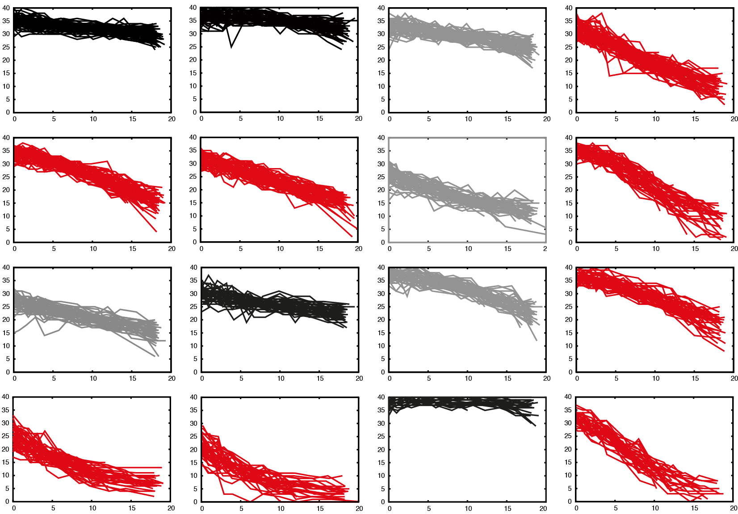
Progression types
fast
non-linear
slow
Notes:
1) Patient visists vs. ALSFRS total score, like example before
2) Different progression patterns occur (fast/intermediate/slow, also non-linear progression)
3) Makes it more difficult to predict slopes, as well as… (next slide)

Slide 48
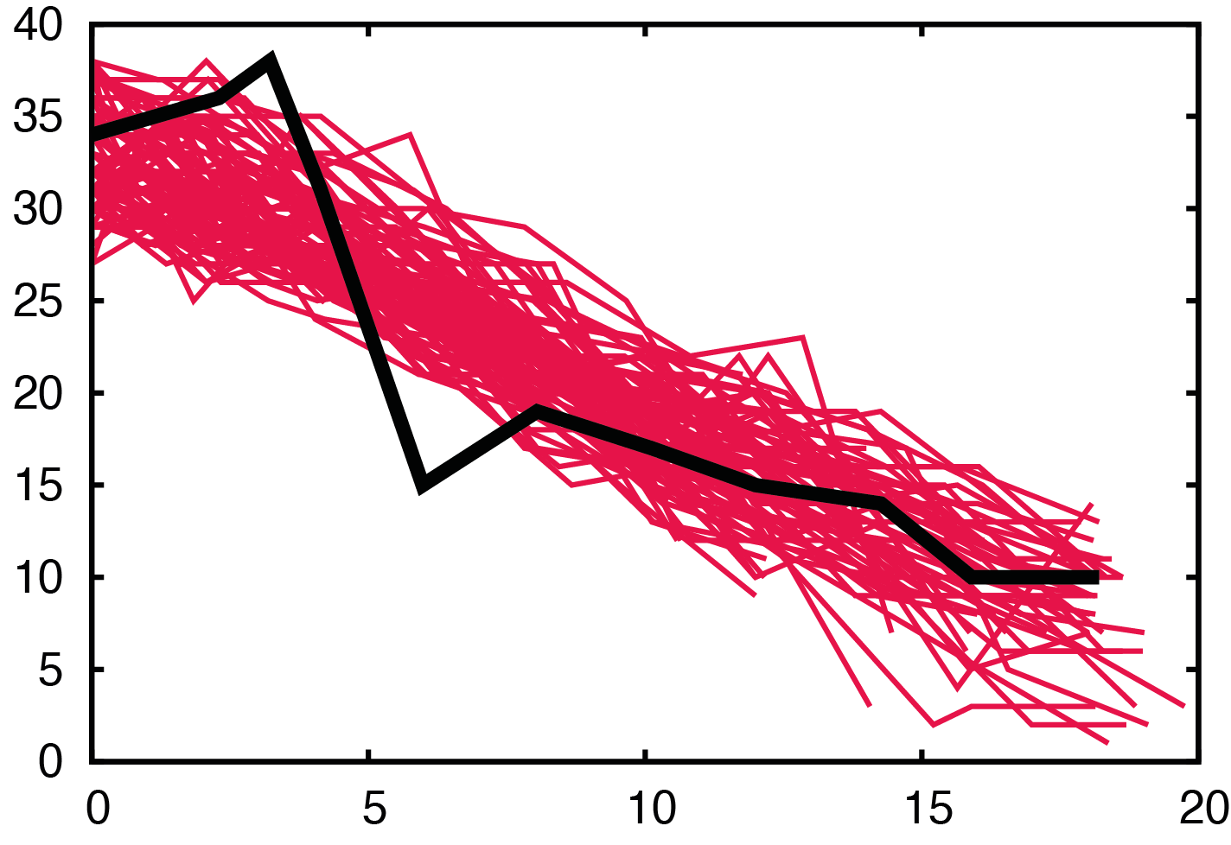
Progression types
Notes:
1) fast progressing sample
2) very hard to predict, significant difference between pattern of 0-3months and 3+ months regions

Slide 49
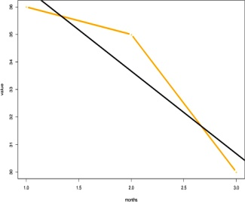
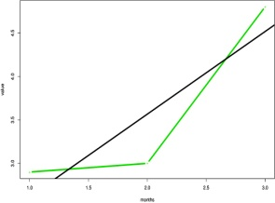
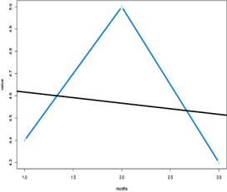
Baseline method:
training
…
…
…
…
…
age | 61
gender | female
onset type | limb
age | 56
gender | male
onset type | bulbar
age | 61
gender | female
onset type | limb
…
…
.…
…
.…
…
…
ALSFRS total
Blood glucose
Potassium
ALSFRS total
Blood glucose
Potassium
39 | 35 | 36 | 34
3.9 | 3.5 | 4.2 | 4.8
4.7 | 5.3 | 5.9 | 5.6
36 | 35 |  | 30
2.9 | 3 |  | 4.8
4.4 | -- |  | 4.3
36 | 35 |  | 30
2.9 | 3 |  | 4.8
4.4 | 5 |  | 4.3
0 | 1 | 2 | 3
slope
intercept
correlation
mean
…
…
months
…
months
Notes:
Main points: 2 different datatypes (constant, time variant), data: different number of visits for different patients, aim: predict diseaseprogression = gold standard slopes
Two different datatypes for p1 (state examples)
2) Same for patient 2, but: different amount of visits!
3) Make data useable for predictions: data -> vector formation where invariable and variable data is combined
4) Invariable data can be used directly
5) Trick for second data type (overcome #visit issue): linear regression → 4 values per feature)

Slide 50

Baseline method:
training
…
…
…
…
age | 61
gender | female
onset type | limb
…
…
.…
.…
SVR
…
…
ALSFRS total
Blood glucose
Potassium
ALSFRS total
Blood glucose
Potassium
39 | 35 | 36 | 34
3.9 | 3.5 | 4.2 | 4.8
4.7 | 5.3 | 5.9 | 5.6
36 | 35 |  | 30
2.9 | 3 |  | 4.8
4.4 | 5 |  | 4.3
36 | 35 |  | 30
2.9 | 3 |  | 4.8
4.4 | 5 |  | 4.3
0 | 1 | 2 | 3
…
…
months
…
months
Notes:
1) with derived feature vector (all data) we can apply std mach learning such as SVR to predict forementioned slopes = predict disease progression!

Slide 51

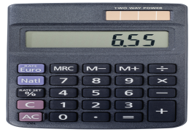
Baseline method:
prediction
training set (1197)
test set (625)
…
…
SVR
trained model
gold standard
predictions
Notes:
Train simple model based on training set and gold standard slopes using SVR
Use the trained model on test data to predict slopes of test data patients

Slide 52

Bootstrapping
Patient 2
Patient 2
Patient 3
Patient 4
Patient 6
Patient 6
Patient 1
Patient 2
Patient 3
Patient 3
Patient 4
Patient 6
One set of patients
Many bootstrap samples
Patient 1
Patient 2
Patient 3
Patient 4
Patient 5
Patient 6
…
Patient 1
Patient 1
Patient 1
Patient 3
Patient 5
Patient 6
Expected variance in quality?
Improvements significant?
Robustness solver ranking?
Notes:
bootstrapping to permute patients + corresponding predictions/slopes
This introduce variation: some patient several times, some not at all
Calculate scores for each sample

Slide 53
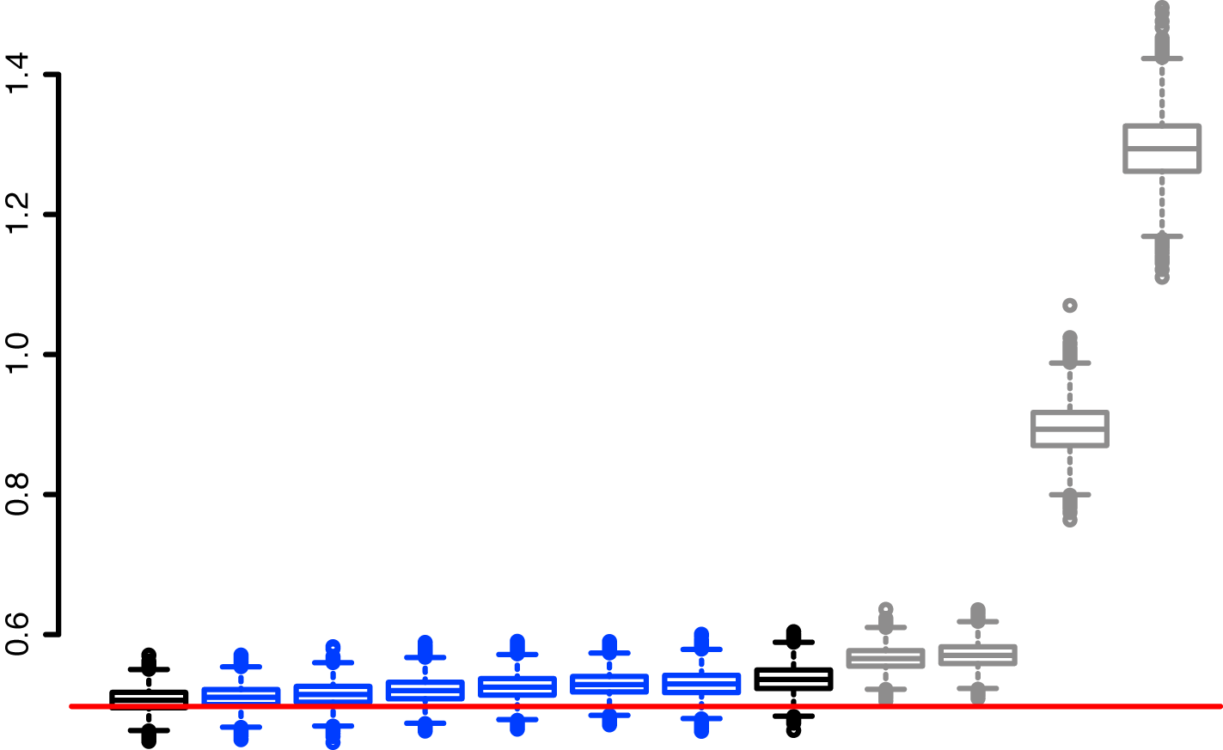
Setting the
baseline
RMSD
Baseline
Better
Two standard
deviations
Threshold RMSD= 0.5
Notes:
First we examined the expected prediction error: smaller is better
Letshave a look at the performance of the baseline method
The performance required for statistical improvement was set to an RMSD of 0.5…
Because this would mean an error of 2std below our baseline method

Slide 54
Root Mean Squared Deviation
RMSD
Aggregate
Baseline
Better
1
2
3
4
5
6
7
8
9
10
Notes:
Of 39 participants that submitted working solutions to the leaderboard
here show 10 final submissions
the 4 not so good, 6 better articipants, and our baseline method
aggregate: predicted slope averaged across 2 best perfs
participants almost reached the threshold but did not beat it
even the aggregate stayed above the threshold
This means, predictions of solvers 1-6+a+b not statistically different

Slide 55
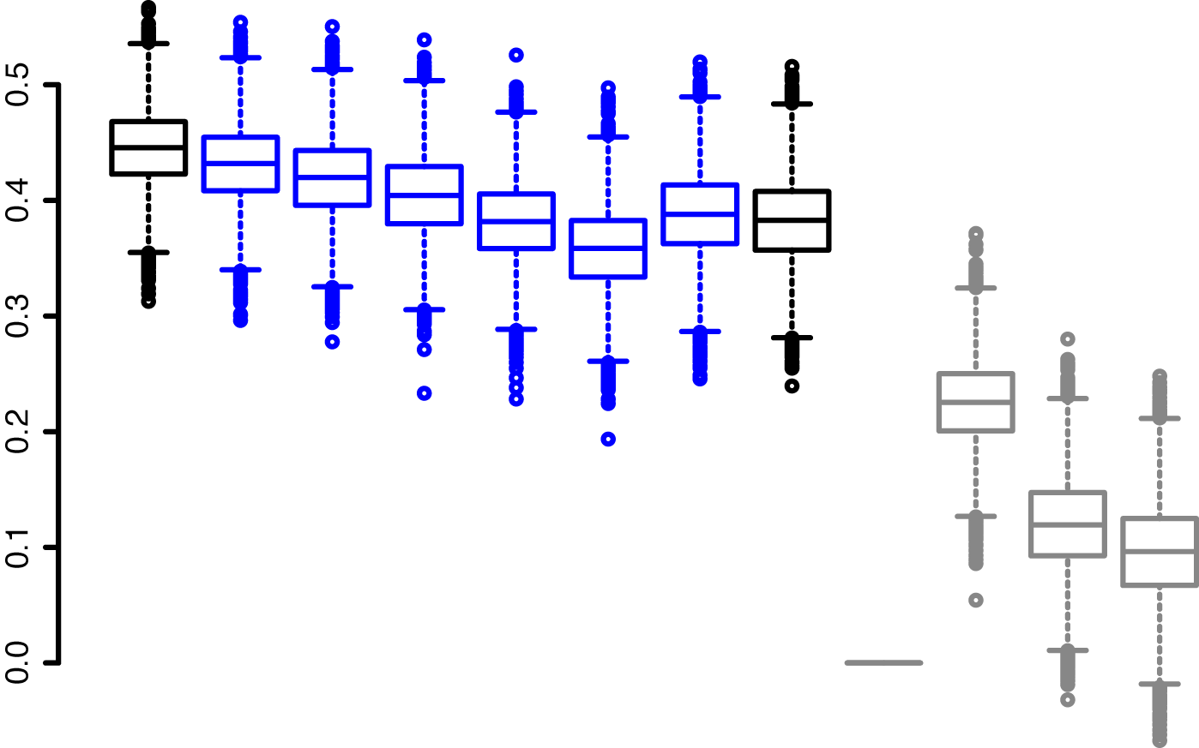
Pearsons
Correlation
Pearsons Correlation
Better
1
2
3
4
5
6
7
8
9
10
Aggregate
Baseline
Ranks based on RMSD
Notes:
As a second measure used PC to assess quality of predictions
contrast to rmsd, PC is relative measure: evaluates if the trends are predicted correctly so values closer to 1 are better
consistant with rmsd, not significantly better than baseling
but serves to illustrate gap between 1-6 and 7-10
perhaps wonder about solver 7: predicted the same value for every patient, variance and PC =0

Slide 56
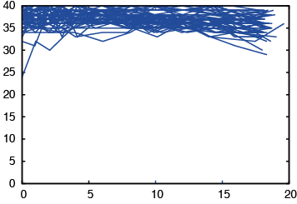
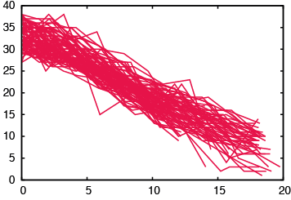
RMSD
slow vs. fast
fast
slow
all
slow
med
fast
1
0.51
0.52
0.52
0.53
0.53
0.53
0.57
0.57
0.89
1.30
0.43
0.43
0.40
0.42
0.44
0.38
0.46
0.47
0.92
1.04
0.29
0.30
0.30
0.31
0.30
0.34
0.26
0.36
0.61
1.43
0.78
0.79
0.84
0.83
0.82
0.88
0.91
0.88
1.04
1.67
2
3
4
5
6
7
8
9
10
Different solvers predict slow or fast progressors more reliably.
Larger (absolute) errors in case of steep slopes.
Notes:
This plot shows the rmsd performance of solvers color coded: red=better, blue =worse
Analyze all patients: color corresponds to overall ranking
Changes if only subsets of atients are examined
Best predictor of slow patients just 6th overall

Slide 57
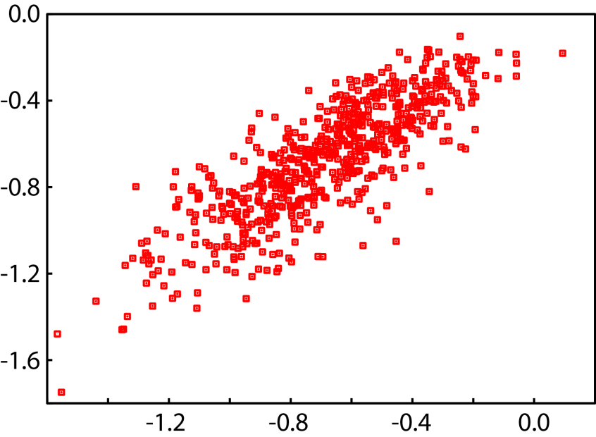
Similarity between
Predictions
Predicted slope
Predcted slope
True slope
Predicted slope
Slopes vs. Predictions
Predictions first vs second
Predictions more correlated to each other than to real slopes:
room for improvement?
Notes:
Comparing predicted+measures slopes considerable error as shown by deviation from diagonal
Pairwise comparison shows that Predictions much more similar between performers : utilize similar signals

Slide 58
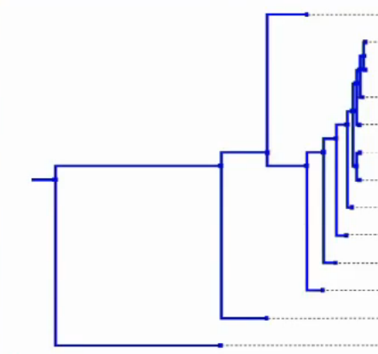
Similarity between
Predictions
Gold standard
short branch =
similar predictions
1
BART
Aggregate
2
6
Random forest
3
4
5
Nonparam. regression
Baseline: SVR
7
Prediction of mean
8
Linear regression
9
Multivar. regression
10
Linear regression
Notes:
This pairwise similarity between solvers depicted as dendrogram: …
Predictions by best 6 performers show strongest mutual similarities
All 6 used nonlinear regression approaches, accumulation of RF
Simpler linear regression approaches worked less well
of course data preparation very important + different between solvers
this and other detail presented in subsequent talks

Slide 59

Algorithms
vs. clinicians
RMSD
Pearsons correlation
0.6
0.8
0.6
0.4
Better
Better
0.4
0.2
0.2
1
2
1
2
Based on 14 patients.
Notes:
We also asked some clinicians to estimate future disease progression giving them the same data
Could not ask them to look at 625 patients: selection of 14 representative patients
Plot shows doctors predictions associated with substantially more error
Consistent with PC: algorithms predictions much better correlated with the true progression
algorithms may provide clinically useful predictions

Slide 60

How to choose
best performers?
Award anyone?
Award one or more?
Threshold
not passed!
Performance
robustness.
Small rmsd difference!
ALS analyses performed?
Ease of application?

Slide 61


Robustness of
first rank
100
100
RMSD
Pearsons Correlation
75
75
50
50
25
25
0
0
1
2
3
1
2
3
Notes:
How did we now choose the winners, as solvers are statistically indistinguishable
examined, for each bootstrap sample, which solver is best
the top 2 perform best in 95, the top three in 99% of the cases
Remaining participants < 1%; consistent with PC
Suggests gold, silver + bronce medal
However, from practical considerations 2nd stood out: able to predict on a patient by patient basis, overfitting
Rather, decided to award two gold and one bronce medal …

Slide 62
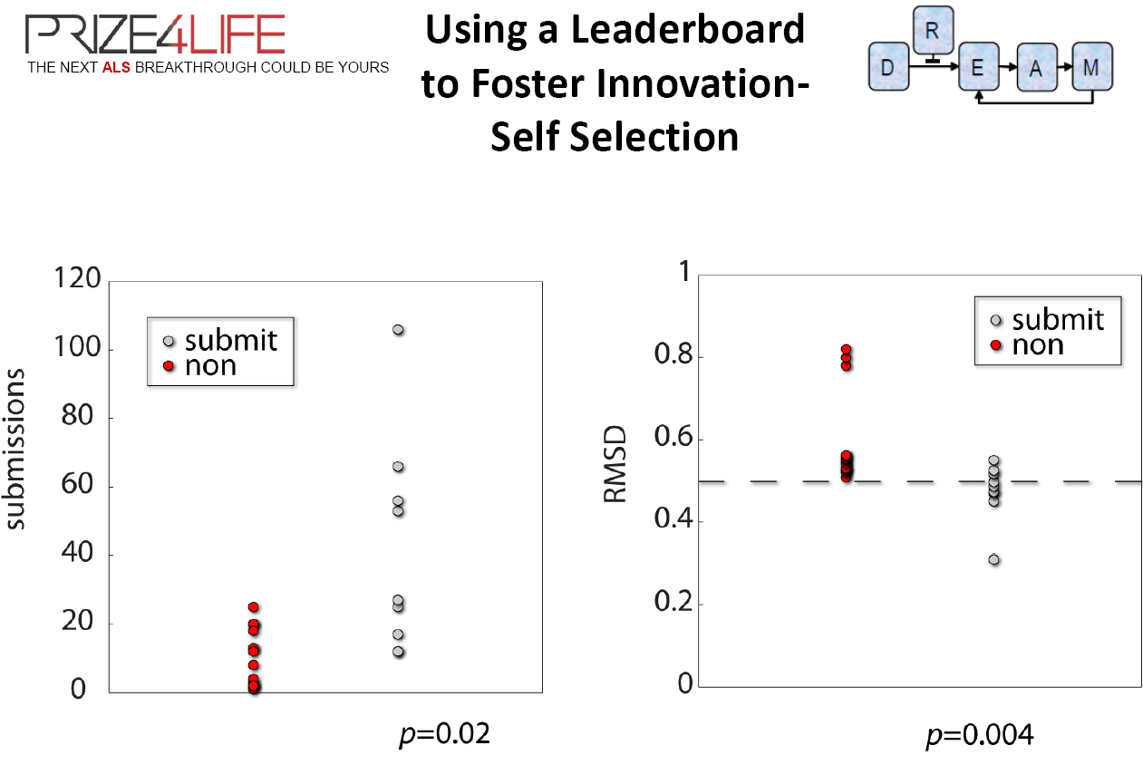
37 solvers submitted to the leader board, but only 12 final submissions
# submissions
Submissions to the board
Results on test set (leader board)

Slide 63
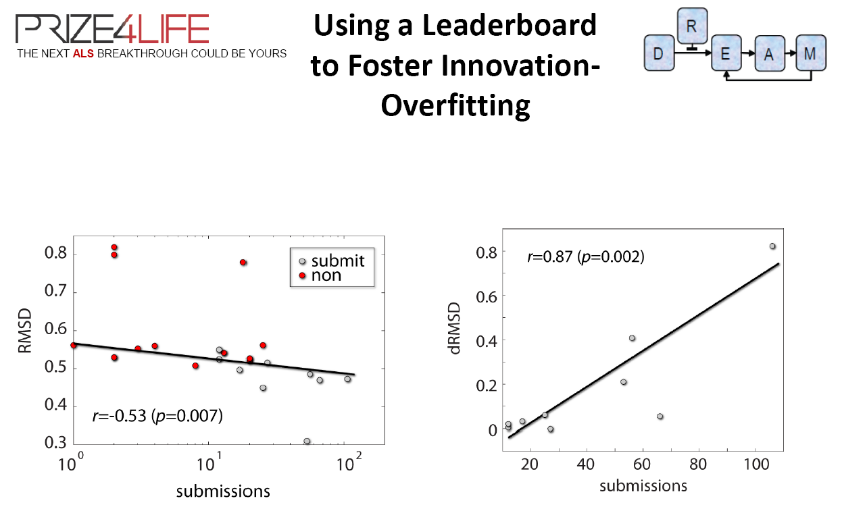
Difference between RMSD on leader board and final validation
RMSD on the leader board
The more submissions, the better RMSD on the leader board
The more submissions, the larger the difference between RMSD on leader board and validation

Slide 64
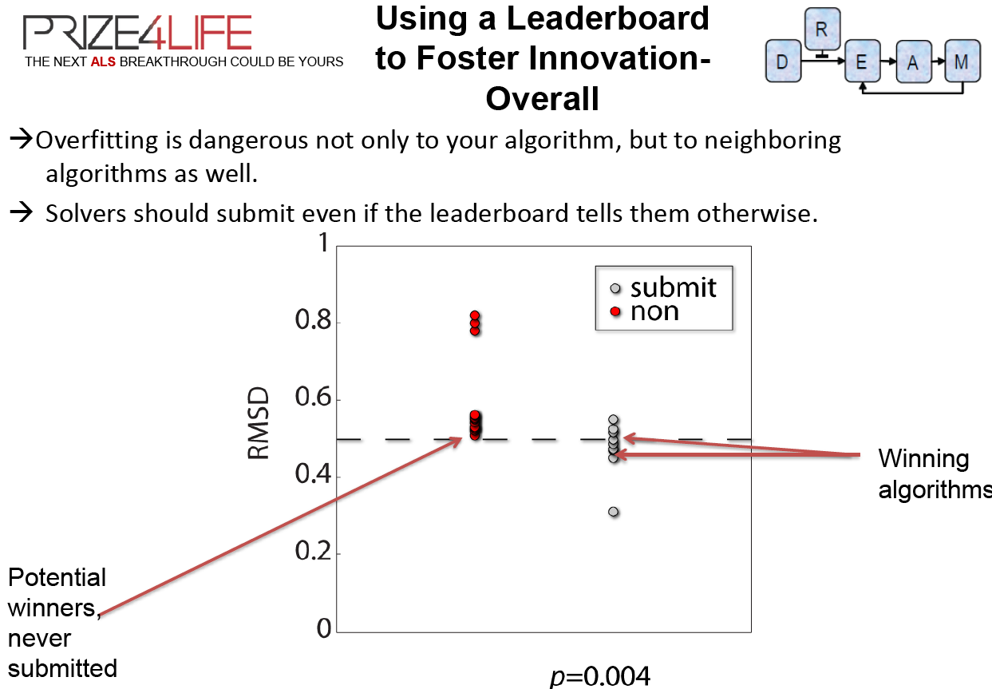

Slide 65
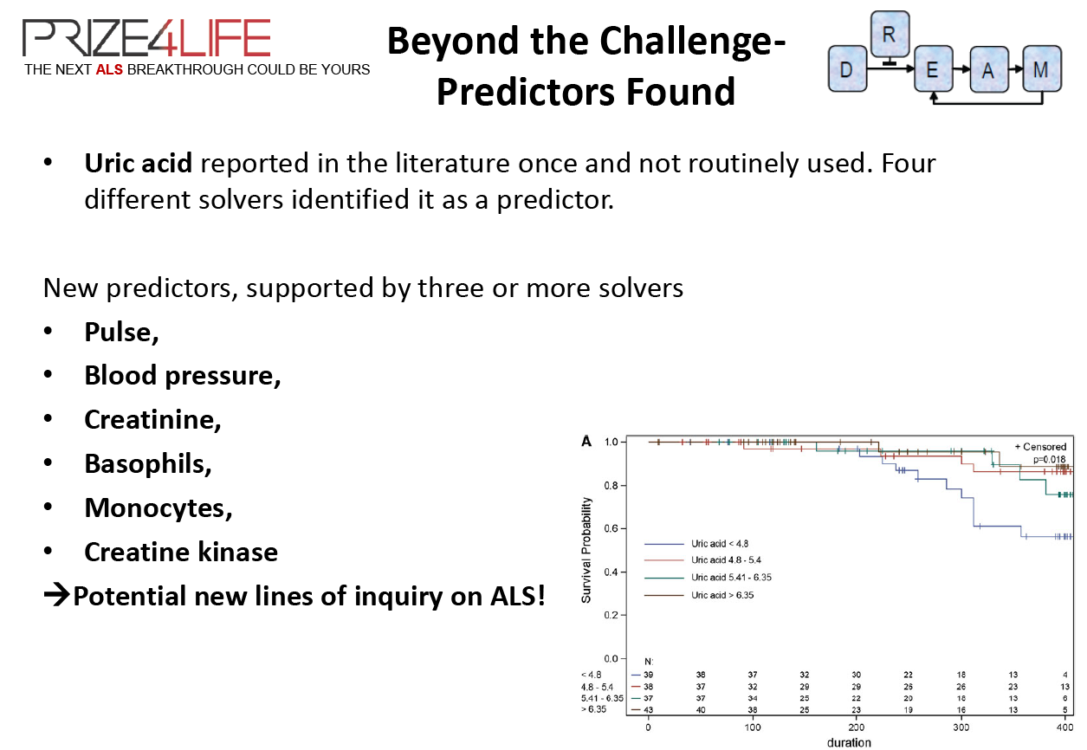

Slide 66
